Slide 1


We deserve arrays • 09.02.2022 • Final

Slide 2
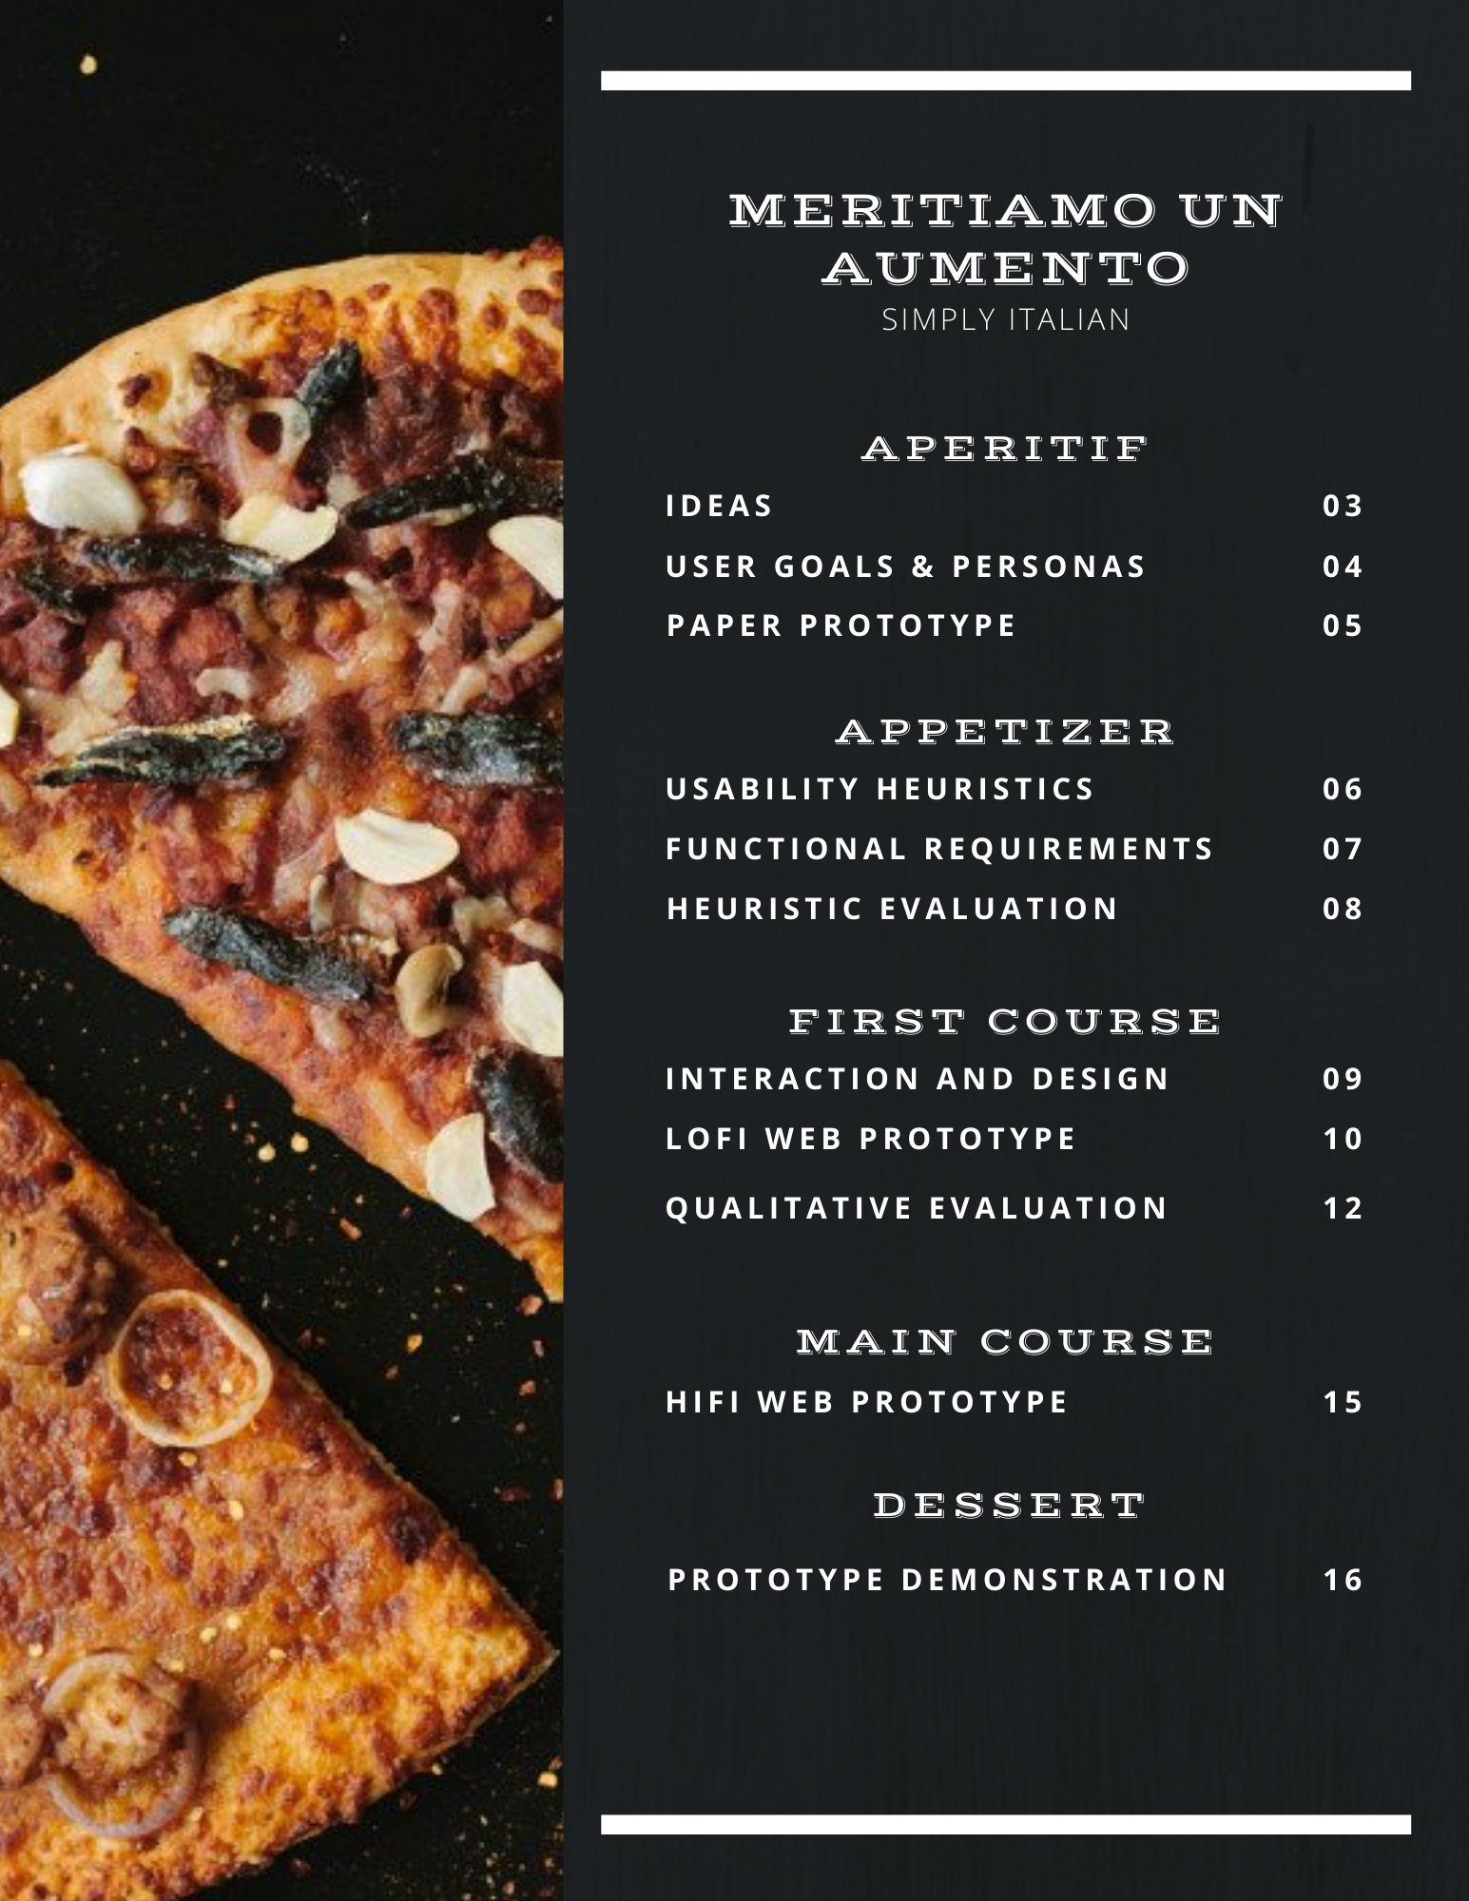

Slide 3
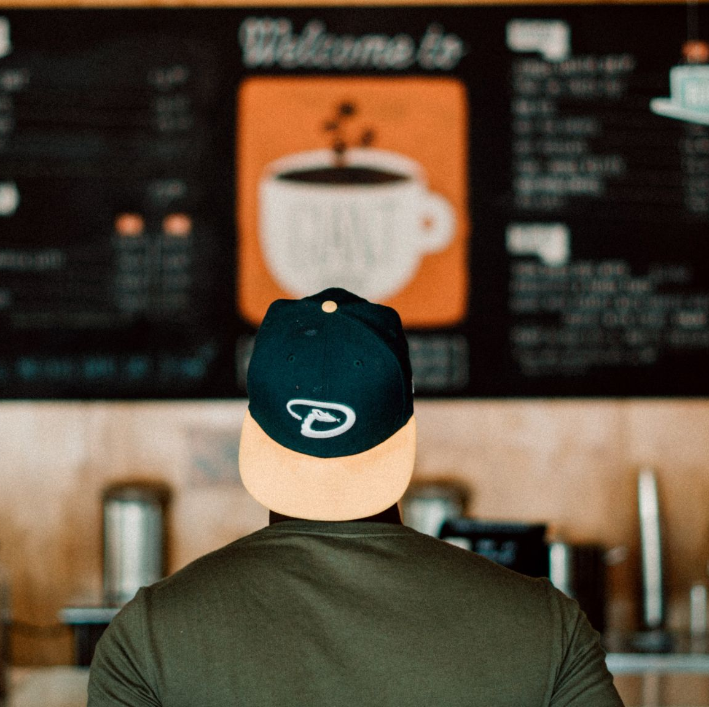
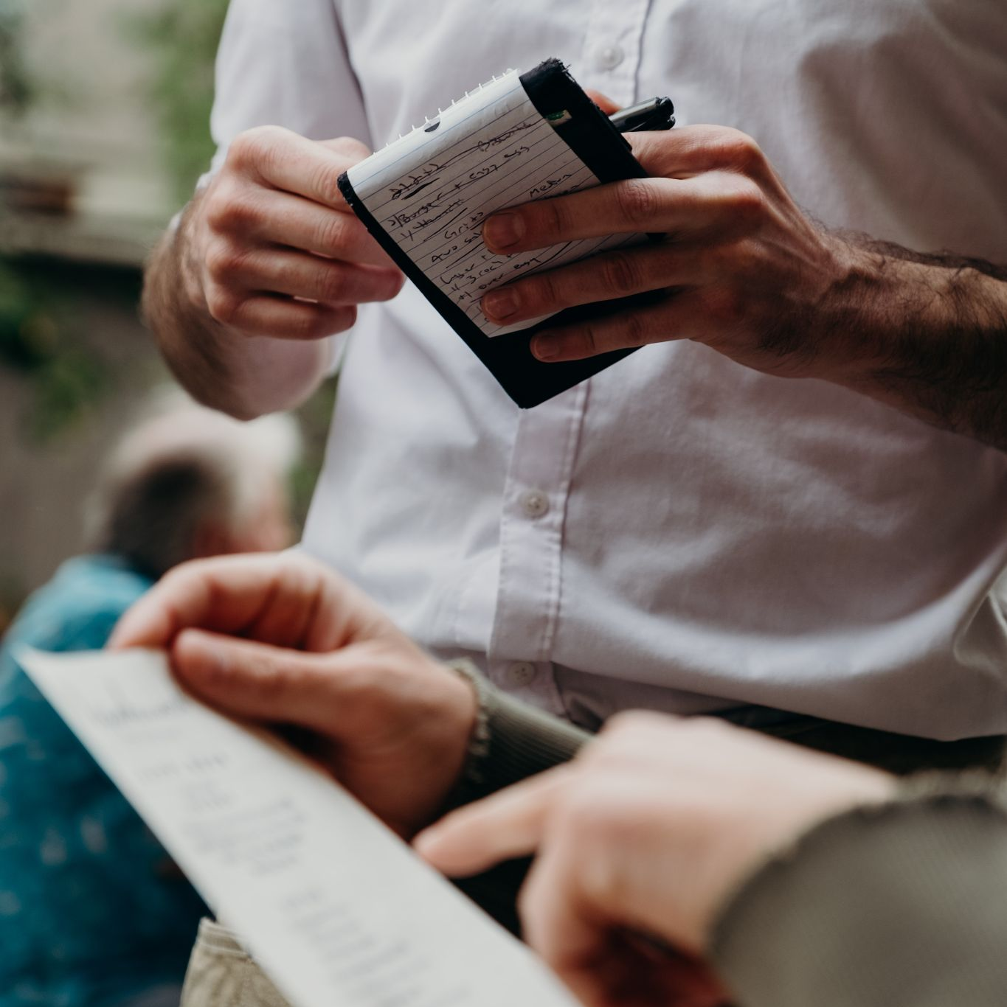
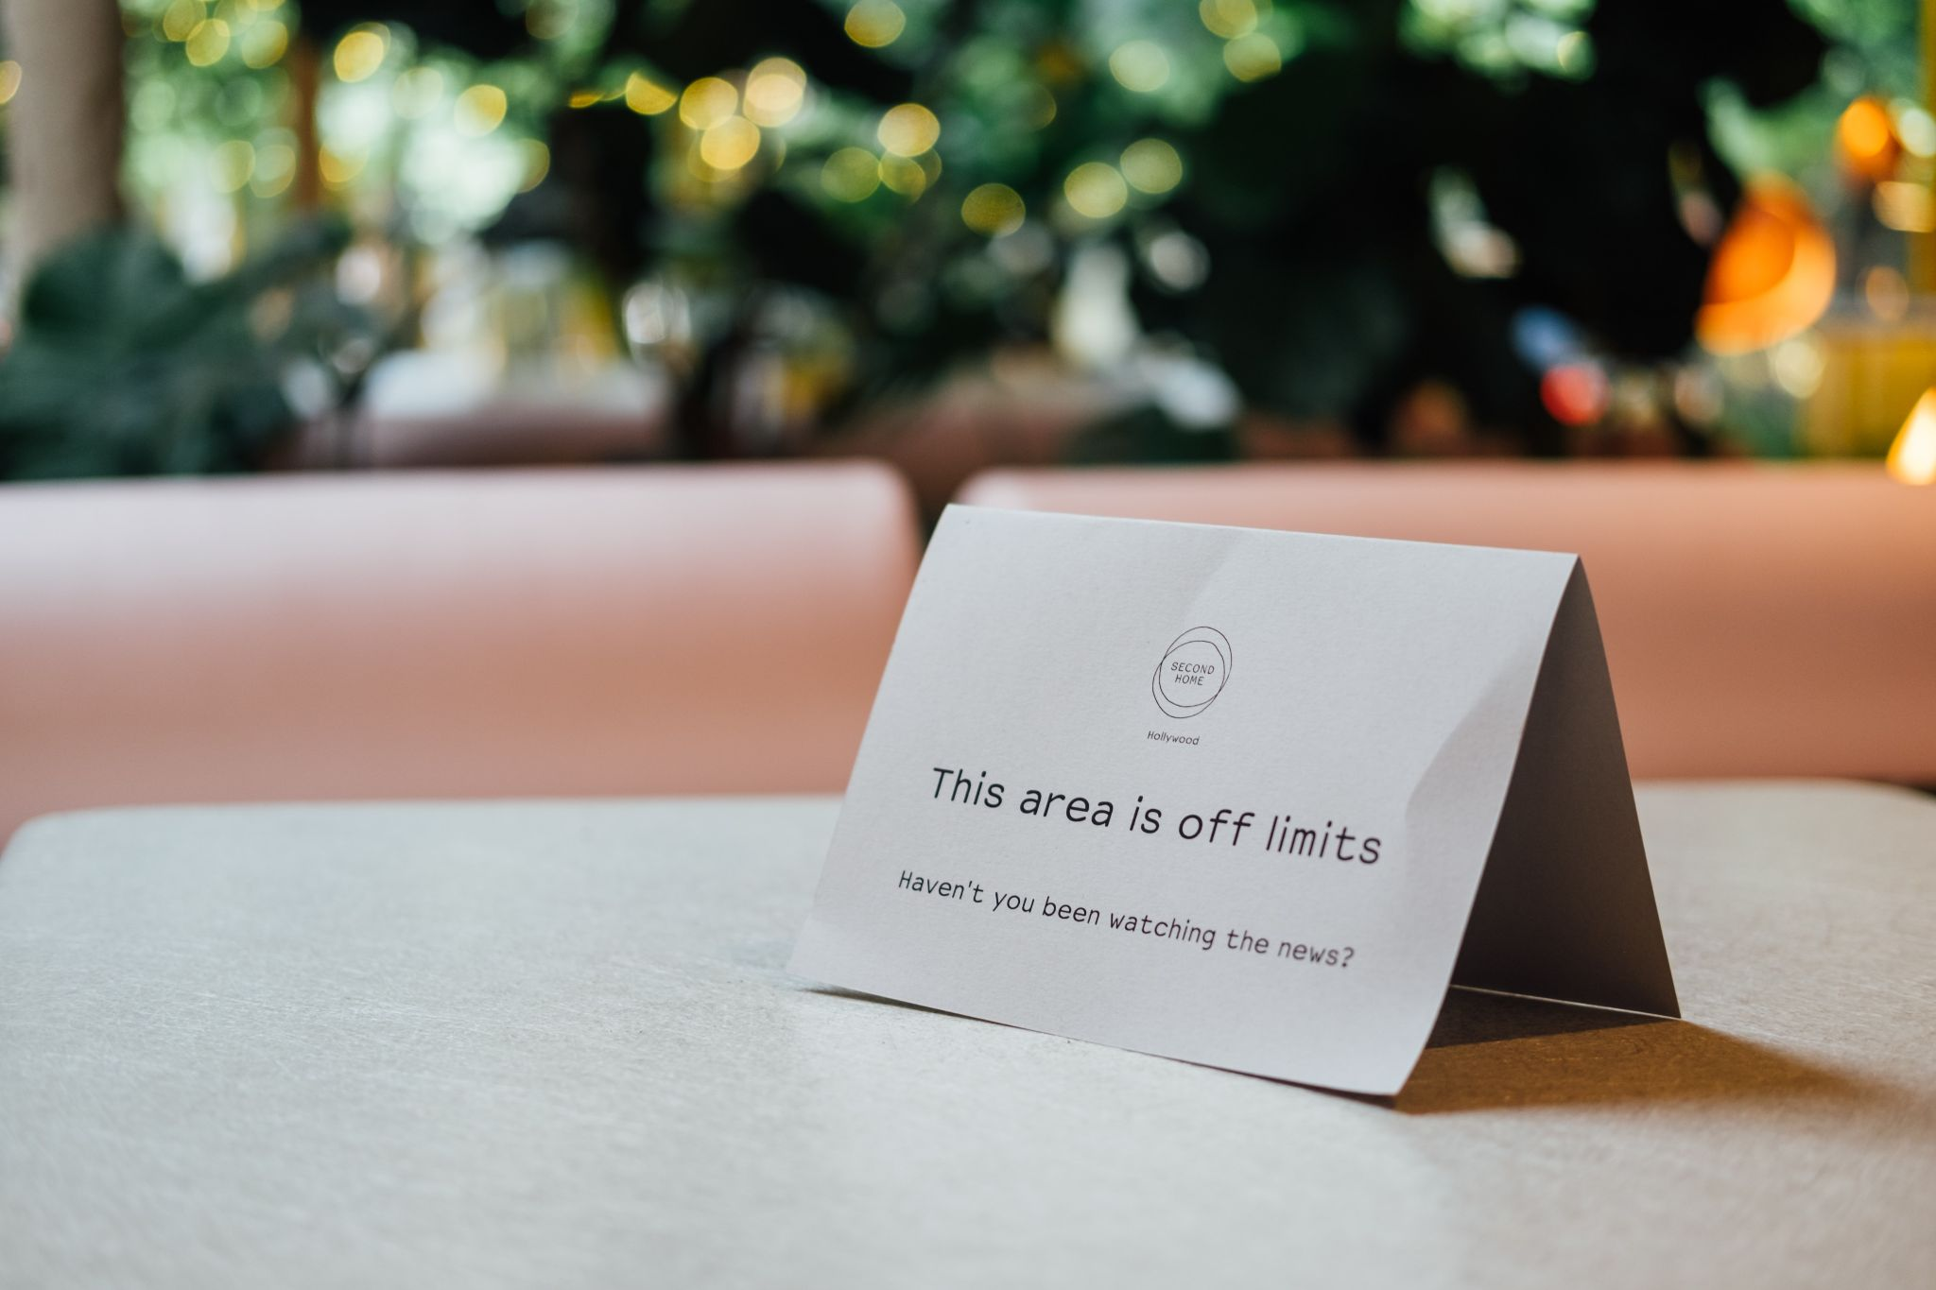
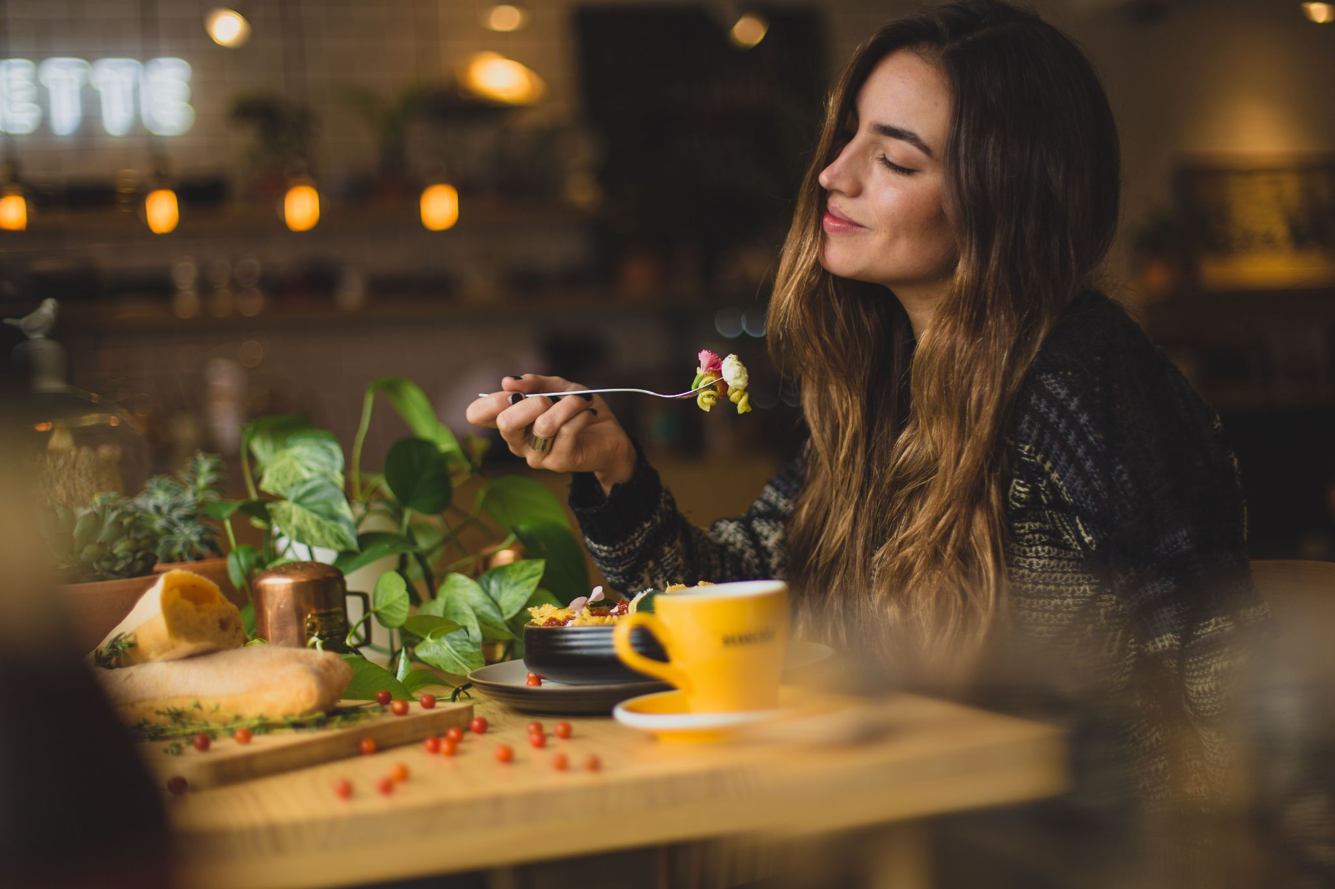
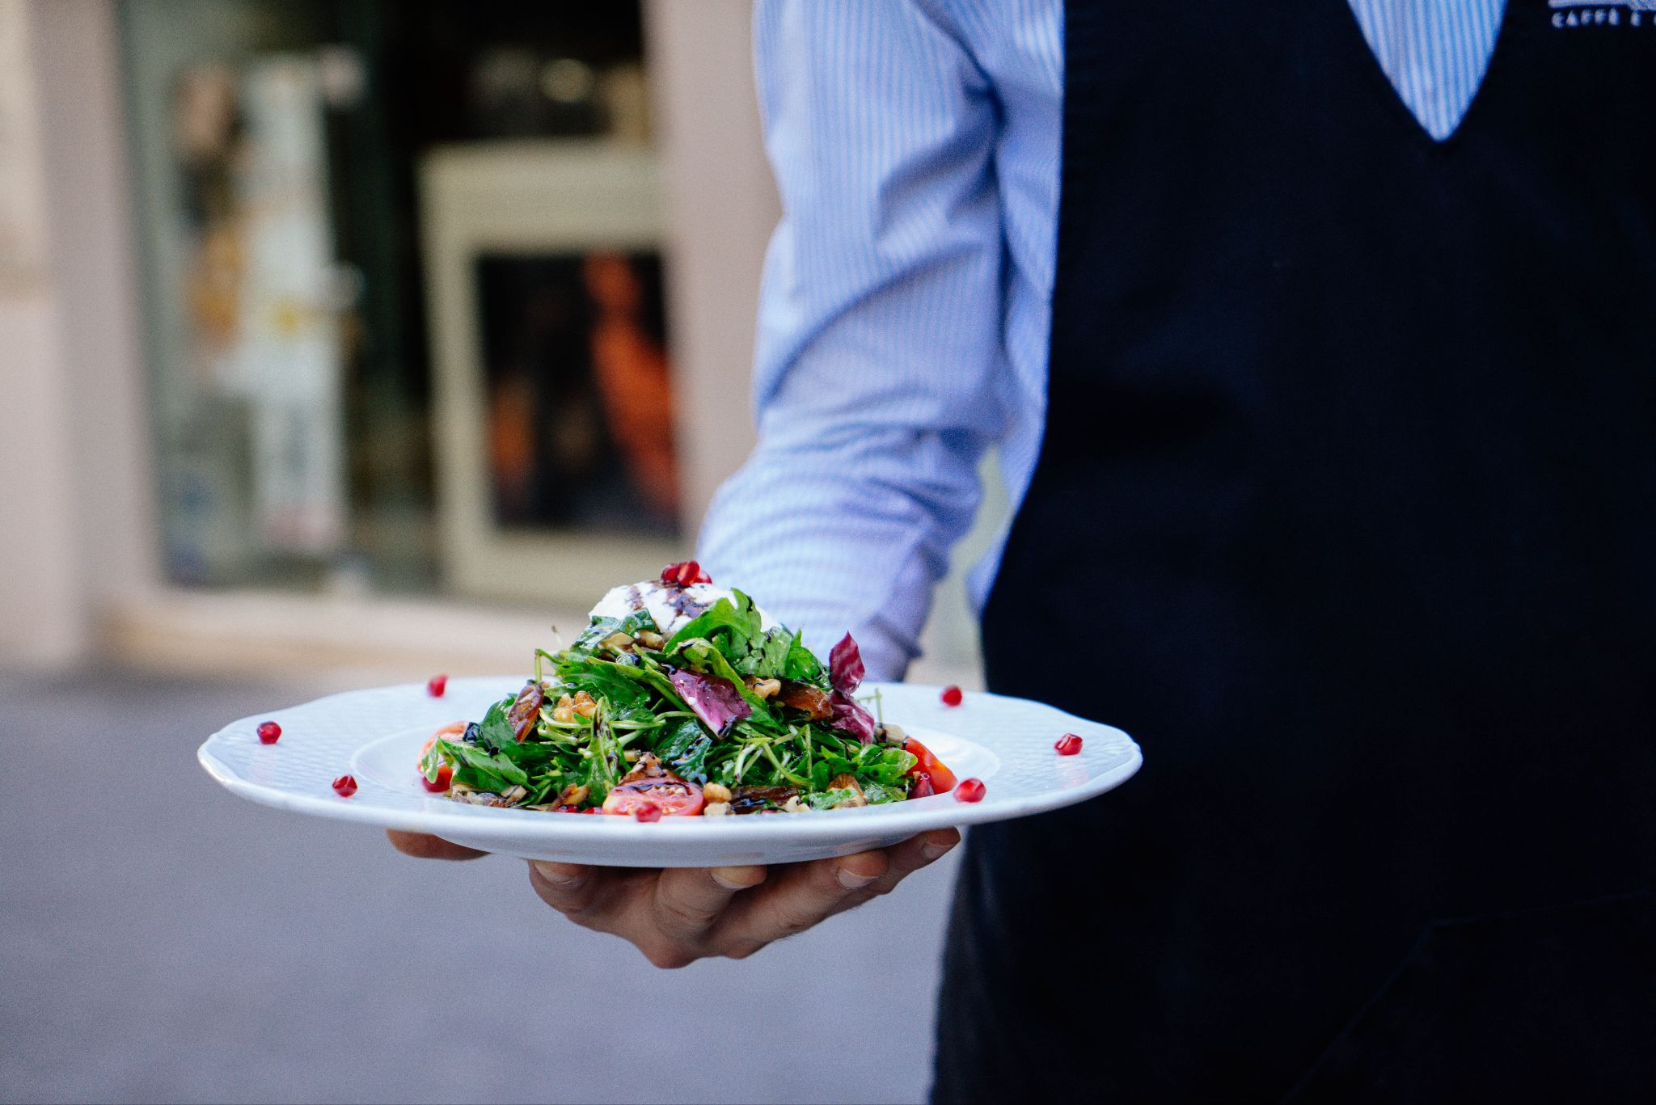
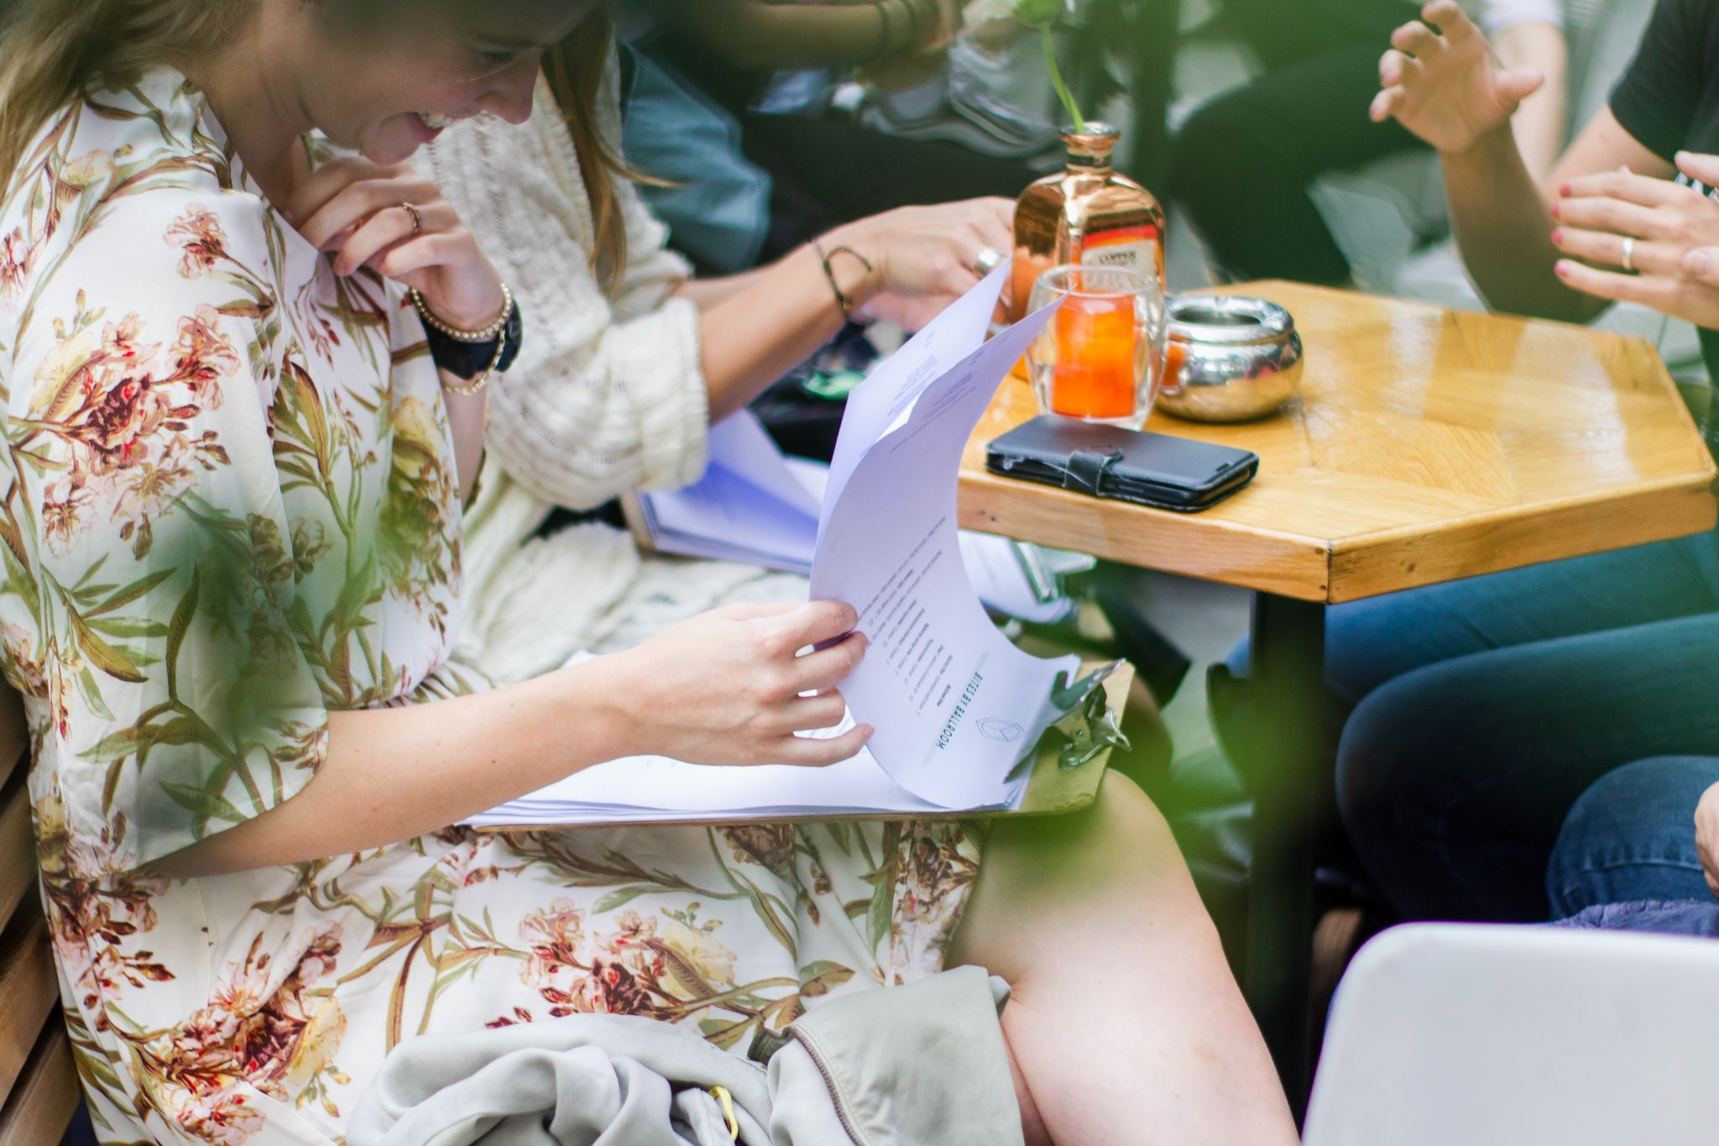
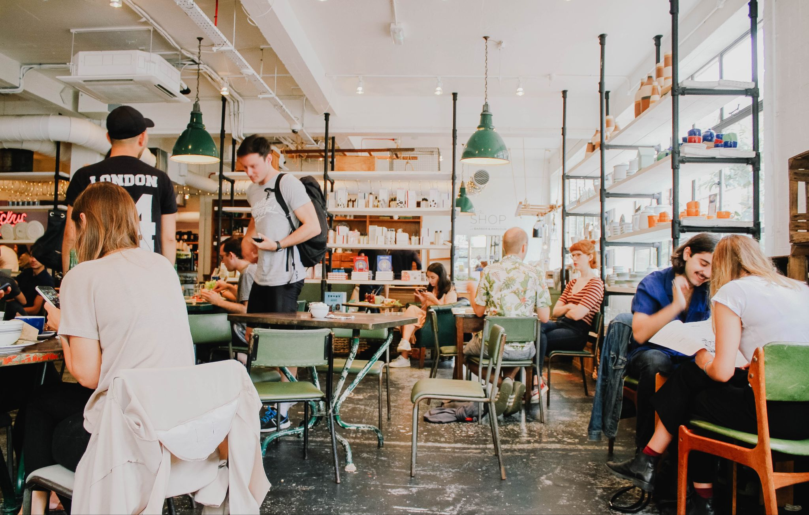
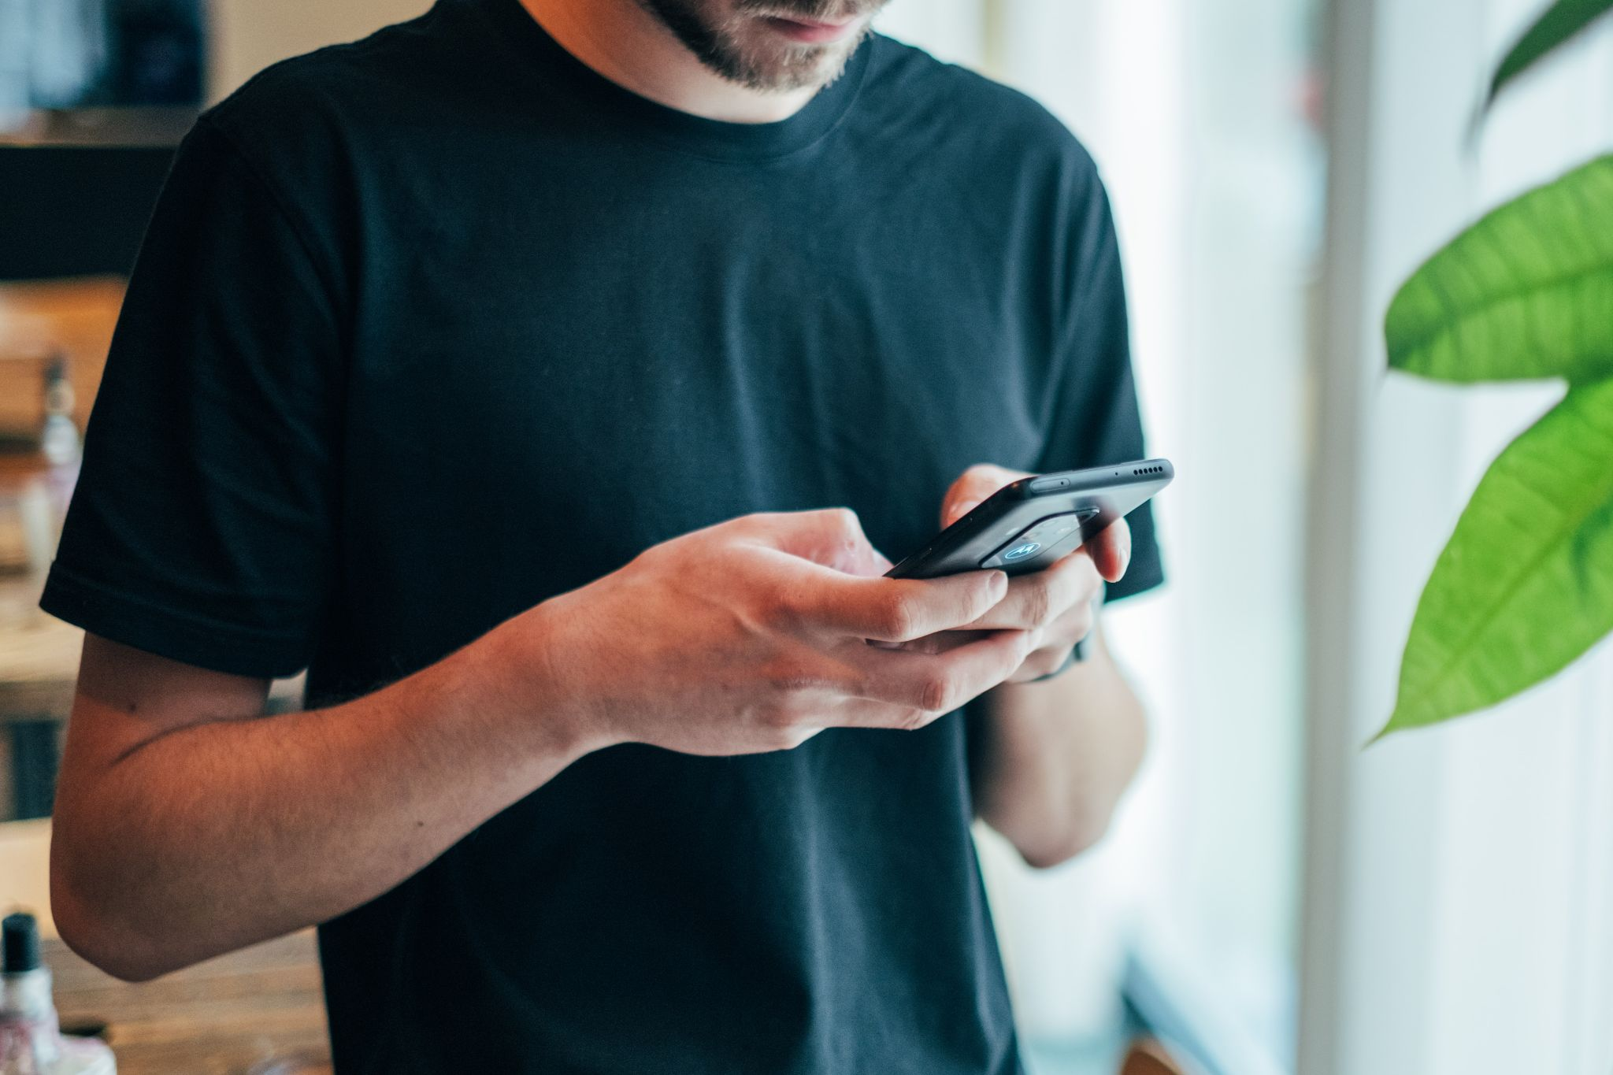
Iteration
I
1
ideas
What's on the menu?
user goals, personas and scenarios
2
paper prototype
3
Notes:
enhance the restaurant experience whether you eat alone or with your friends
decide for yourself how much contact you have with the staff
always have the menu with you and adjust dishes according to your needs
No more searching through ingredient or allergy lists or waiting for the waiter to ask the chef to know if you can eat something
came up with this idea through brainstorming our ideas and then evaluating them with the team
this was our favorite

Slide 4

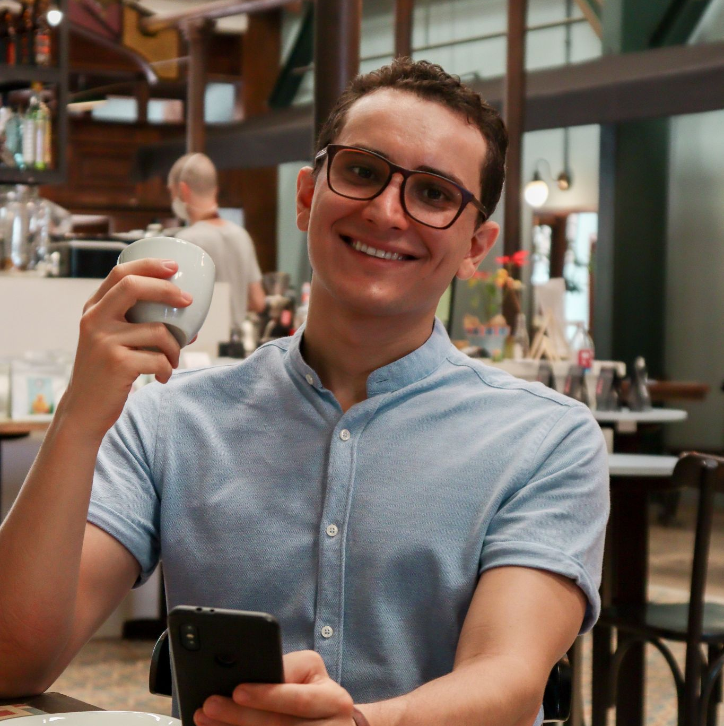

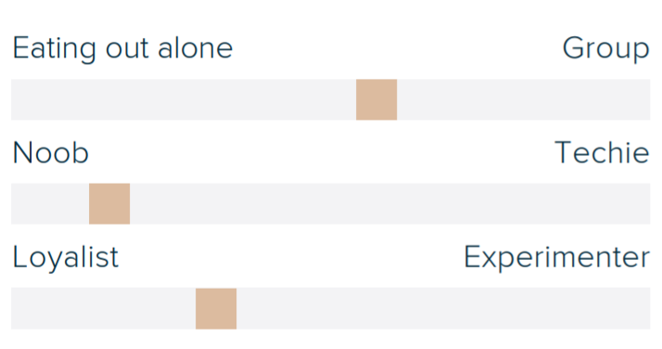
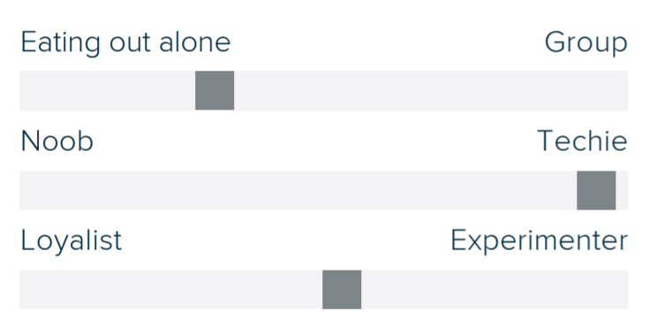
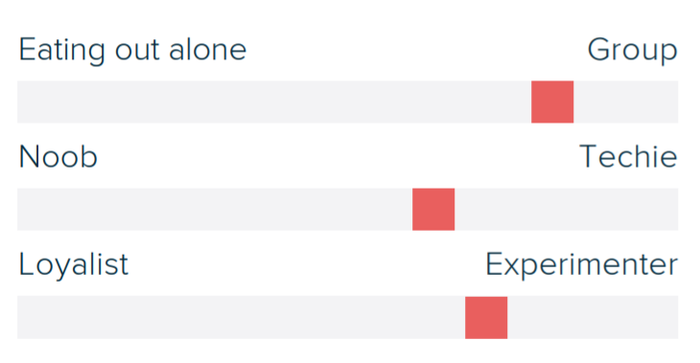
A table for three, please
Iteration
I
1
ideas
user goals, personas and scenarios
2
Mary
the Golden Oldie
Jens
the Digital Introvert
Luna
the Social Butterfly
paper prototype
3
Notes:
conducting structured interviews with potential users; which was basically anybody who might visit a restaurant; to find out wishes and potential problems of our idea
focused on their typical restaurant visit and also the willingness to use technology
condensed them into 3 personas
main differences:
willingness to use technology
willingness to visit a restaurant alone or talk to the staff
willingness to talk to try something new

Slide 5
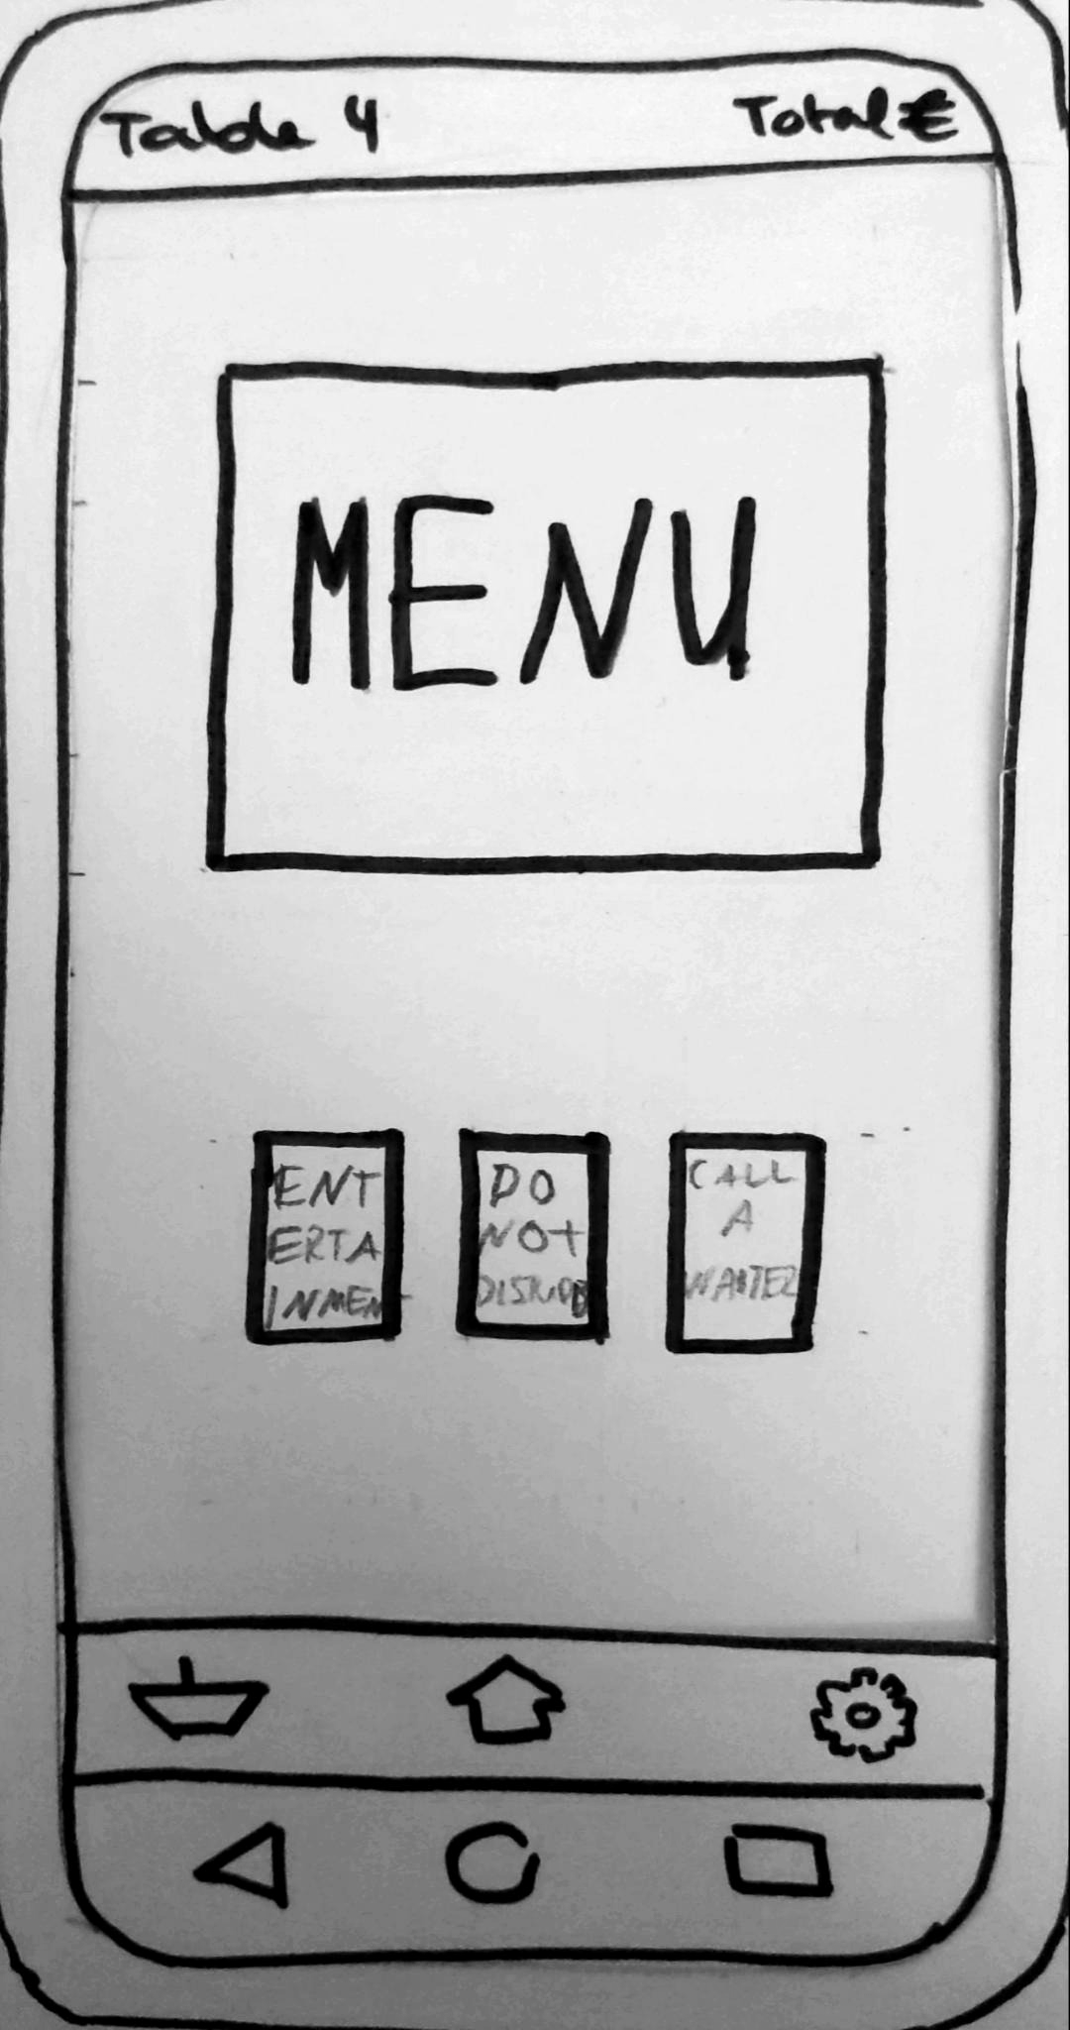
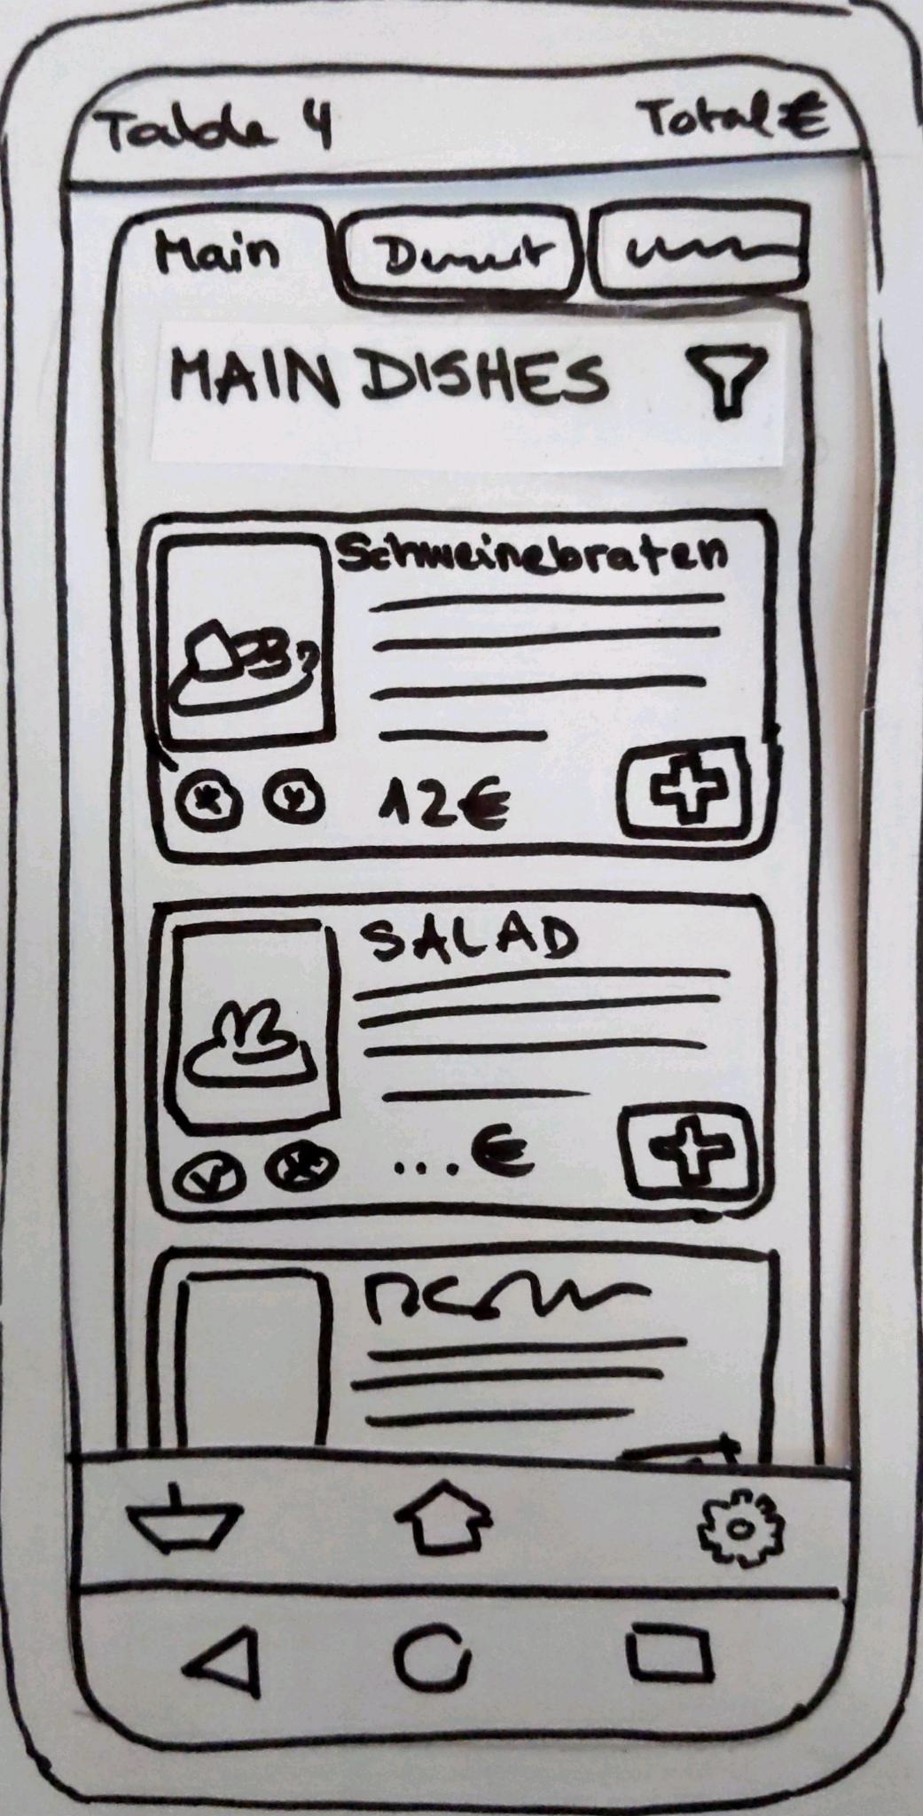
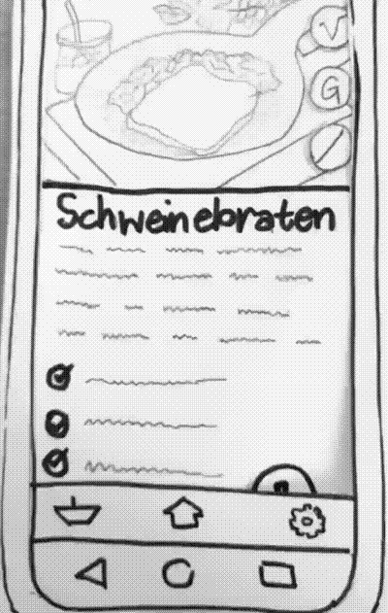
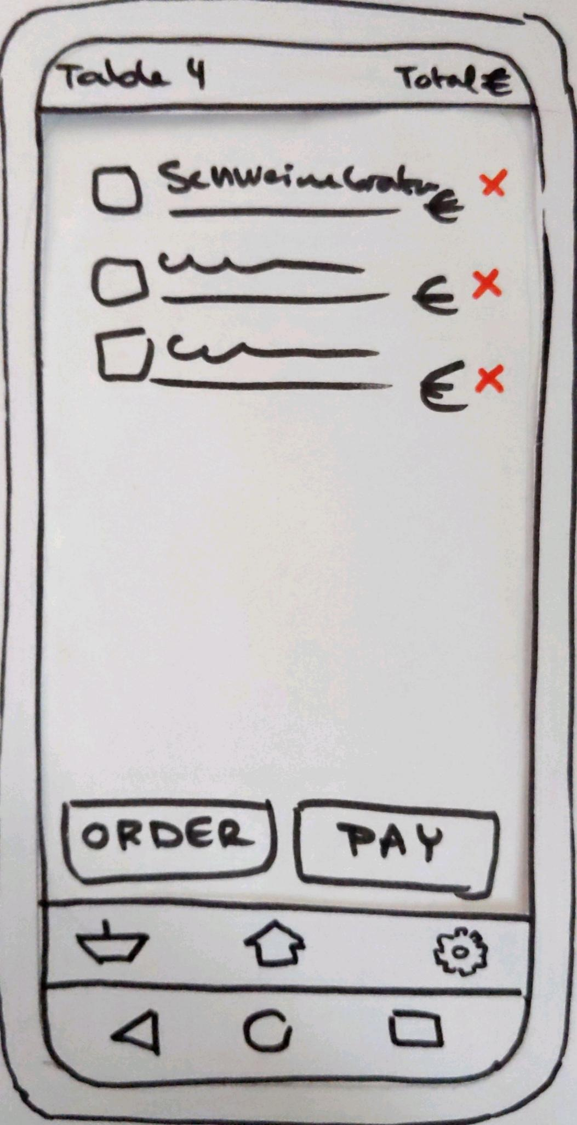
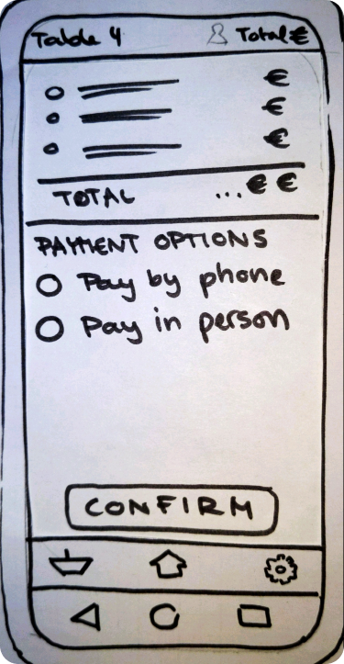
Are you ready to order?
Iteration
I
1
ideas
user goals, personas and scenarios
2
3
paper prototype
Notes:
based on our research, the personas and our ideas for the app we came up with: our first Prototype

Slide 6
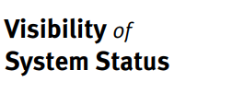
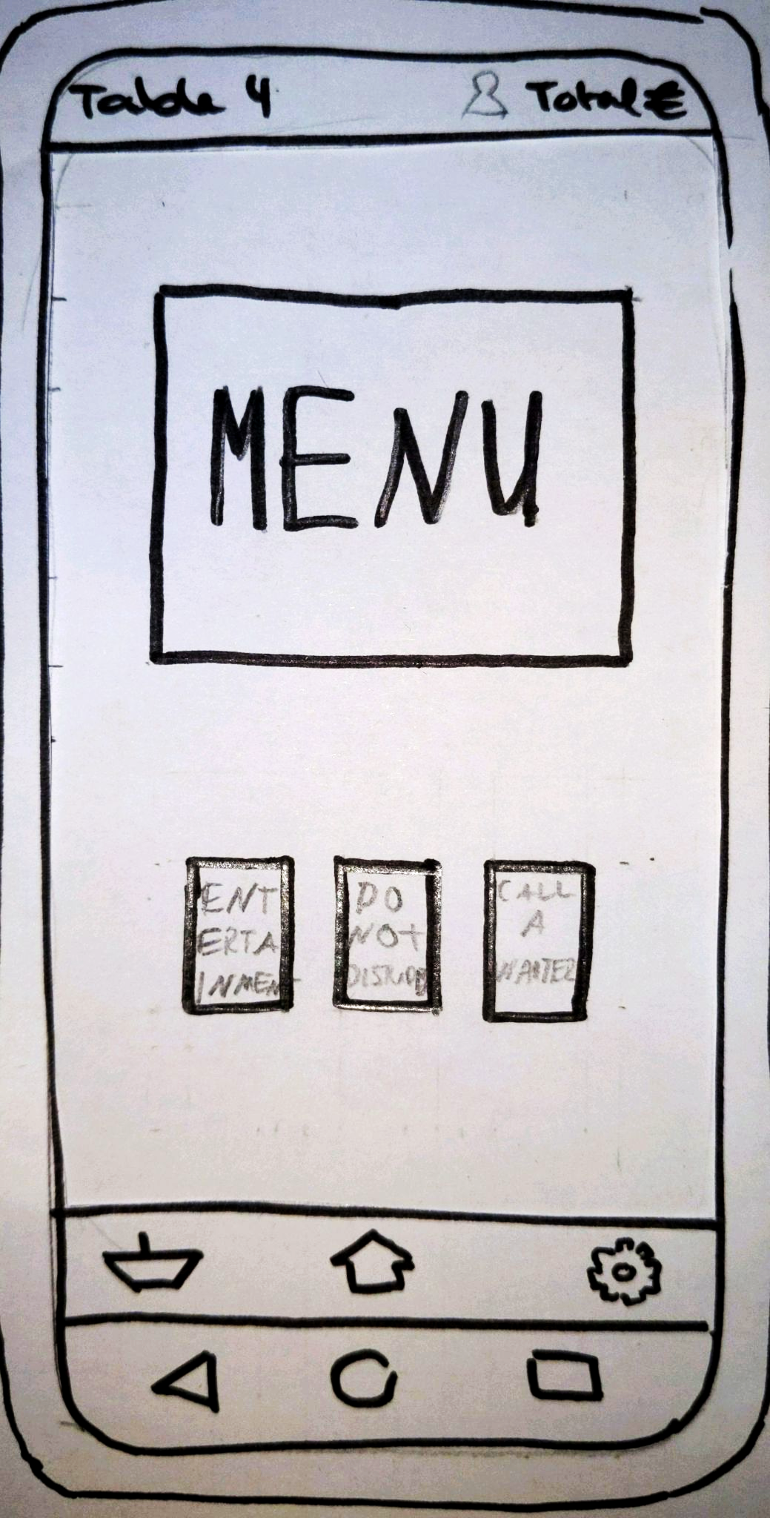
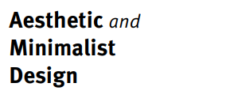
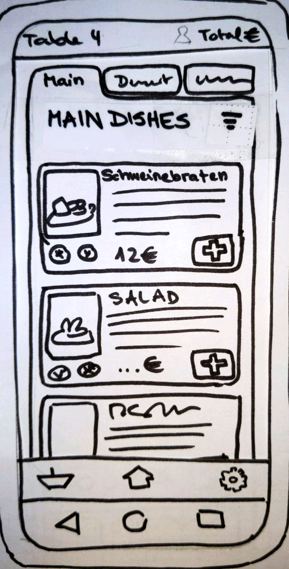
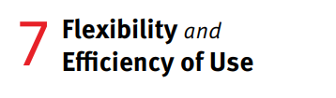

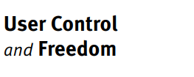
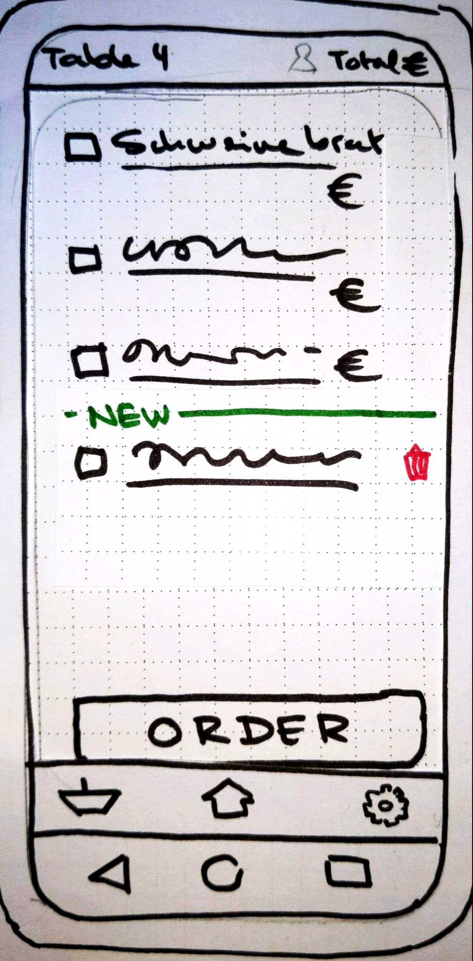
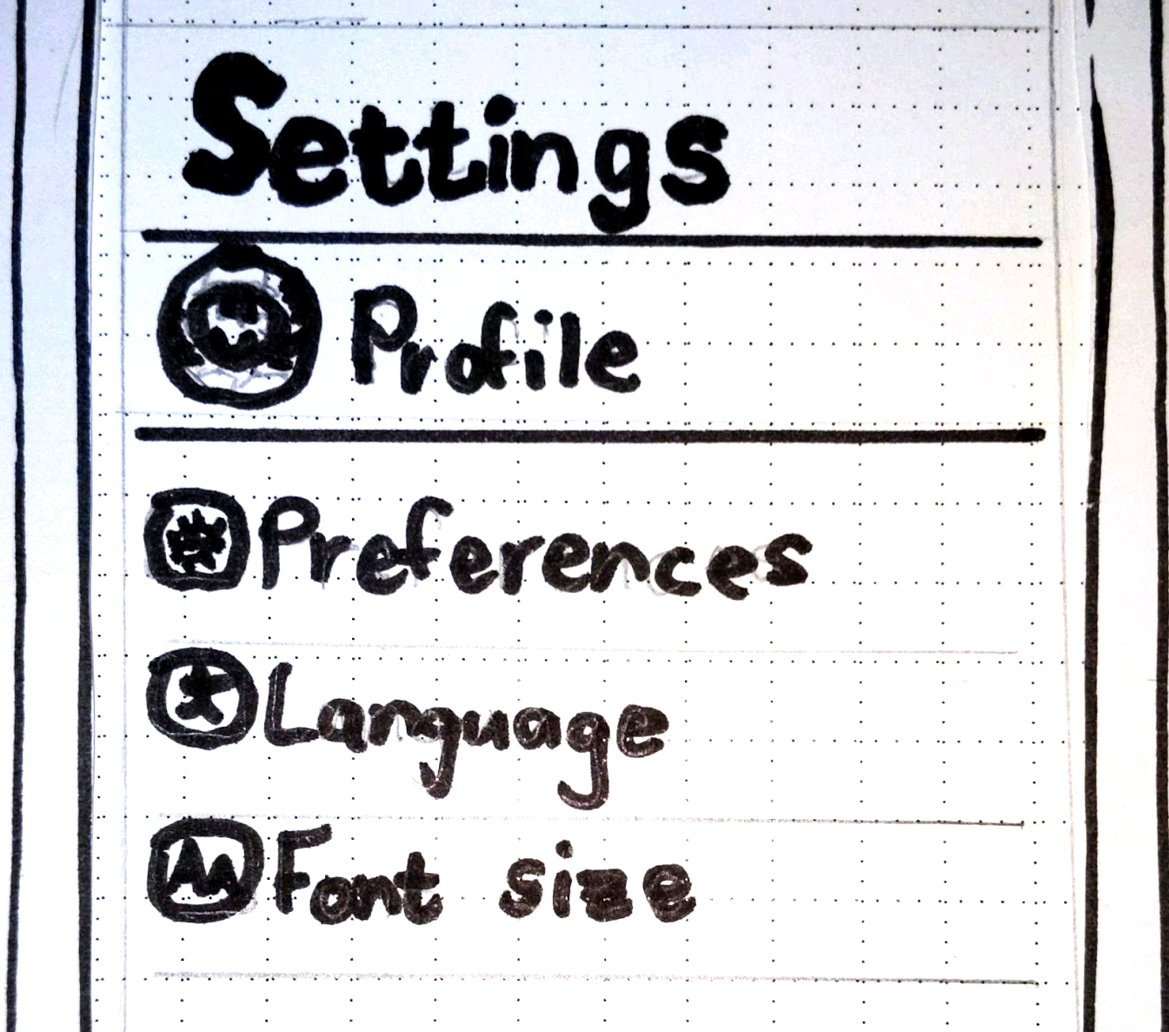
Usability Heuristics Applied
Iteration
II
4
Usability Heuristics
Functional Requirements
5
Heuristic Evaluation
6
Notes:
Talk about Nielsen’s Usabilty heuristics involved in the development
Heuristic 8 and the simplified home-page’s design
Heuristic 1 and 7 involved in the dish selection screen
Heuristic 5 involved Ordering screen
Heuristic 3 involved in

Slide 7
Requirements that sparked a change
Iteration
II
Main functions accessible with one click
Current status visible at all times
User can order within 15 seconds
Accessible to all users
4
Usability Heuristics
5
Functional Requirements
Heuristic Evaluation
6
Notes:
Talk about the requirements and give an example, where those changed the design:
Main functions :
Redesign of Navbar
Current status visible at all times:
Order icon
User can order within 15 seconds:
Quick pay buttons
Accessible to all users
Dietary and allergic information supplieable

Slide 8

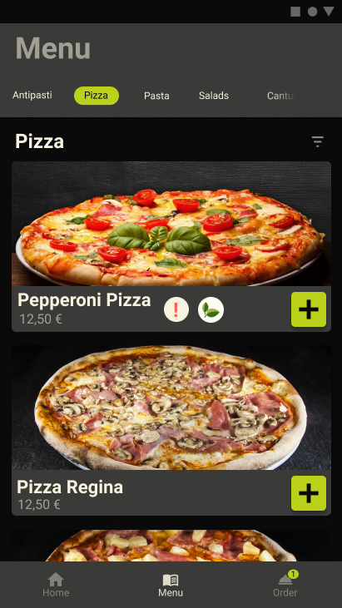
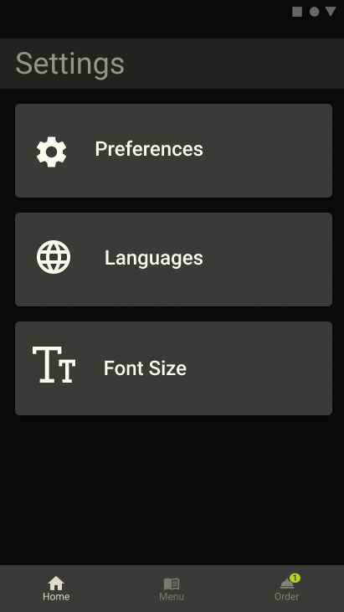
Heuristic Evaluation
Iteration
II
Added text to navbar
4
Usability Heuristics
Added title to each screen
5
Functional Requirements
Removed profile section
6
Heuristic Evaluation
Notes:
dd
Icons: Recognition rather than recall
Title: Transparency system status
Profile: Personalization

Slide 9
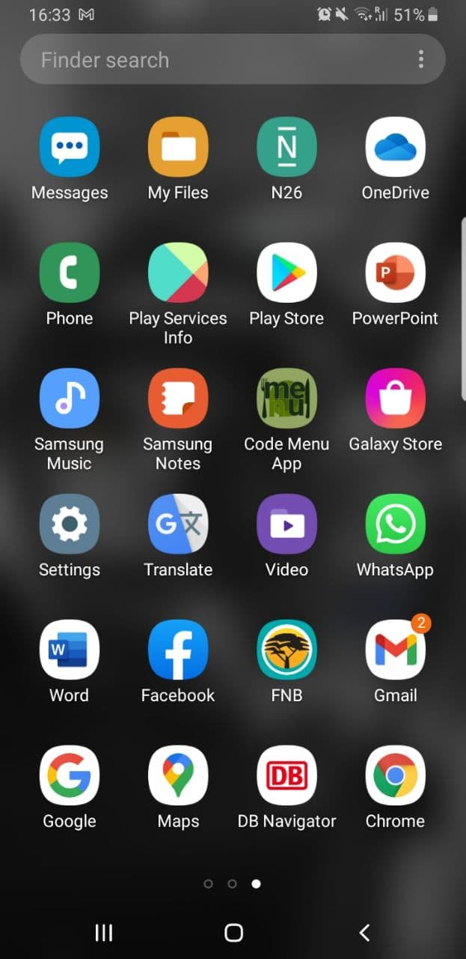




Iteration
III
interaction and design framework
7
Material Design
Framework7
The recipe
styled prototype + lofi web prototype
8
qualitative evaluation, understanding users
9
The dish
Android
Apache Cordova
Notes:
Interaction and design framework:
As our design language we chose material design (beautiful, modern, familiar),
we used framework7, for its easy onboarding, to implement the html prototype … and cordova to build our apk.
Our target device is android as we felt that app would reach a wider audience -> since roughly 72% of smartphones sold in Germany are Android-phones[1]

Slide 10
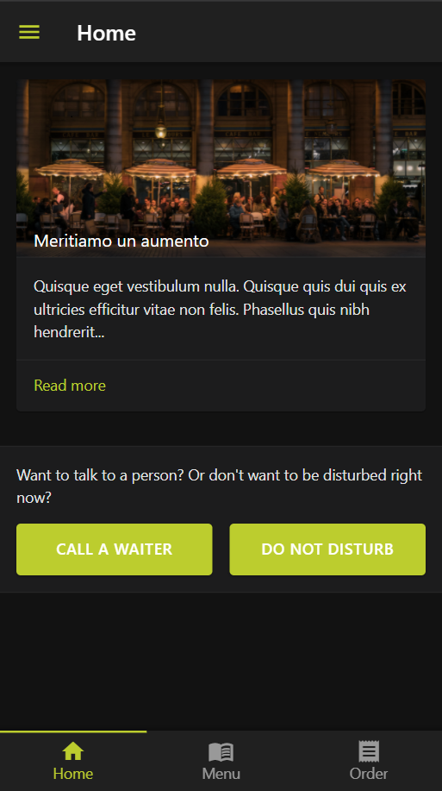
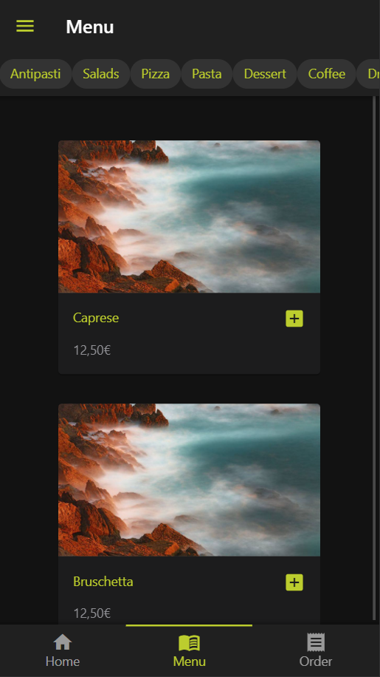
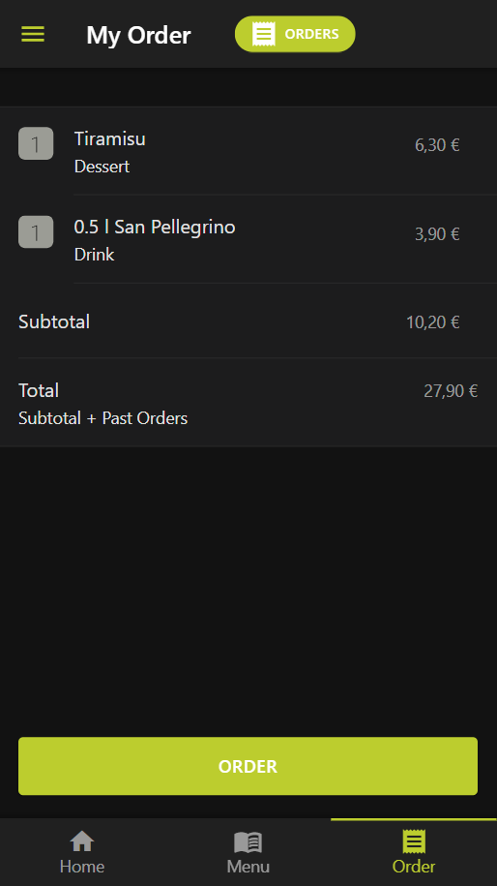
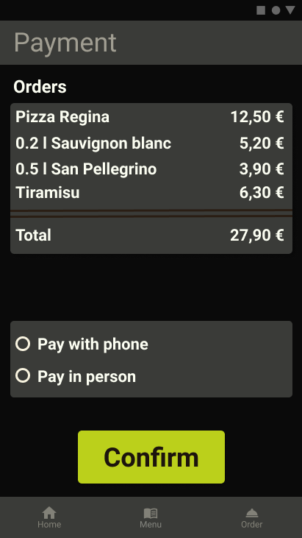
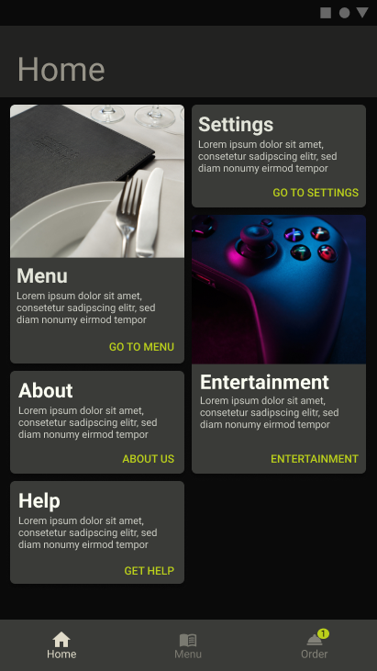

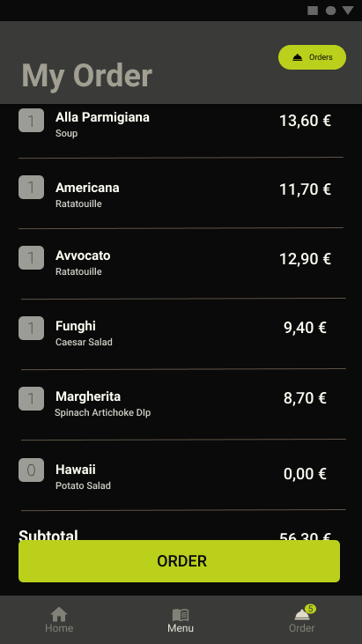
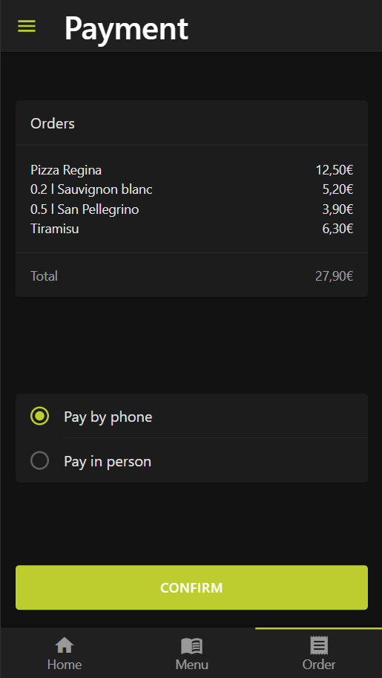
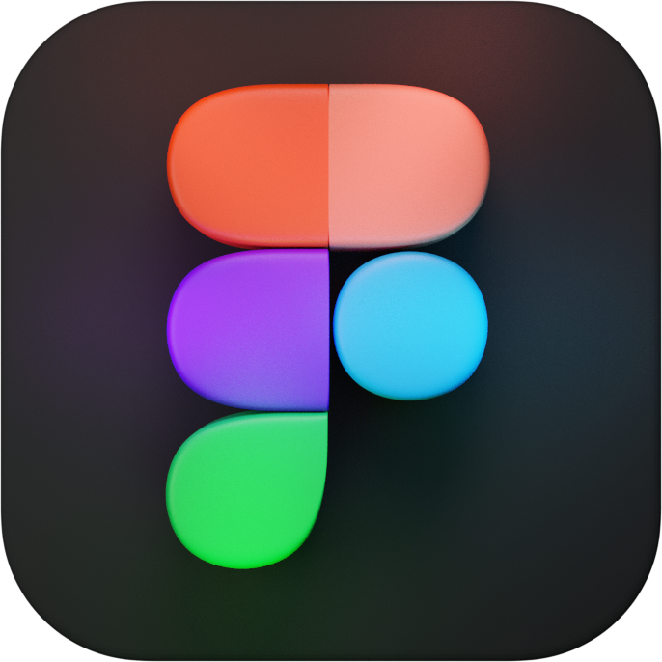
Iteration
Styled Figma Prototype
III
interaction and design framework
7
styled prototype + lofi web prototype
8
qualitative evaluation, understanding users
9
Notes:
Styled Prototype:
For our prototyping tool we used Figma.
And we wanted the colours of our app to feel fresh and organic
Which is why we chose green as our primary colour
For the main ui, we opted for a dark mode as we felt this adds a certain sophistication
to the feel of the applicatio, which suits the restaurant environment

Slide 11
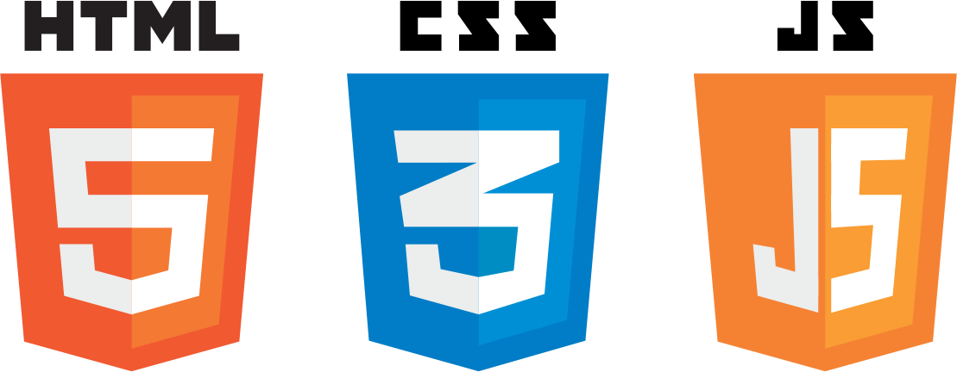
Iteration
Lofi Web Prototype
III
interaction and design framework
7
styled prototype + lofi web prototype
8
qualitative evaluation, understanding users
9
Notes:
Lofi web prototype:
Preceding our evaluation we implemented our html lofi prototype
It was mainly front end, with no real functionality.
And we also made the subjects aware of this fact.

Slide 12
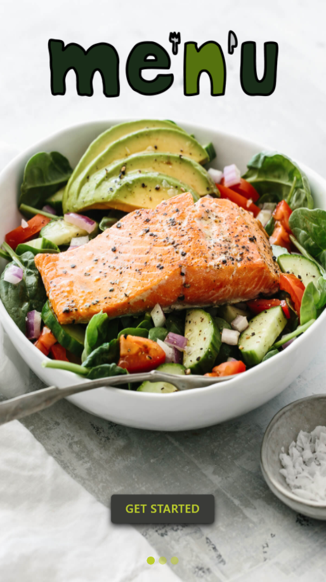
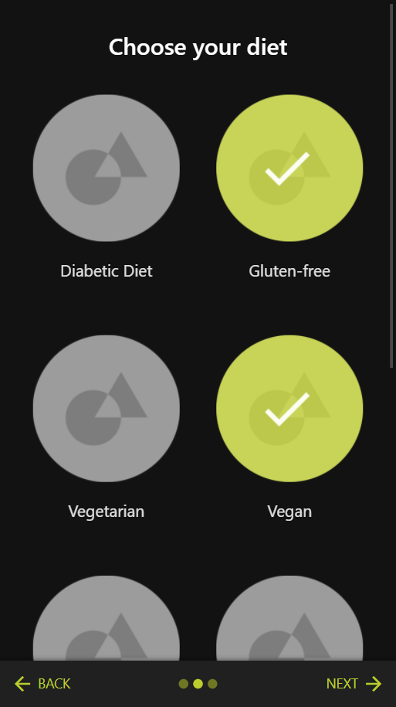
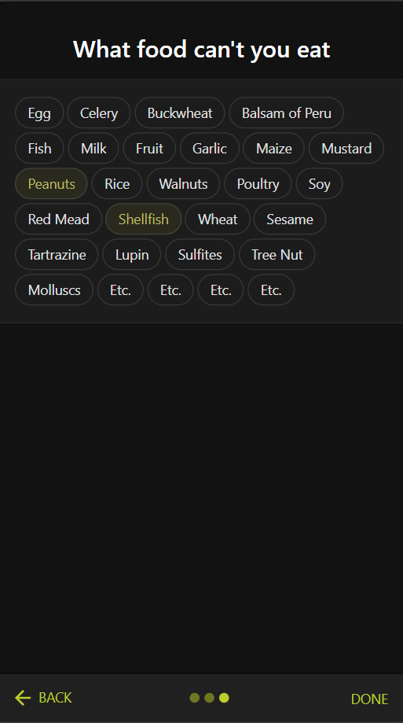
Iteration
Onboarding: fix the sequence & visual appeal
III
interaction and design framework
7
styled prototype + lofi web prototype
8
qualitative evaluation, understanding users
9
Notes:
Qualitative Evaluation:
We received a lot of interesting feedback from our qualitative evaluation:
Mainly:
● users voiced how they felt that allergies had a higher priority than the diet and our application should incorporate this,
and we felt that our screens needed more visual cohesity.

Slide 13
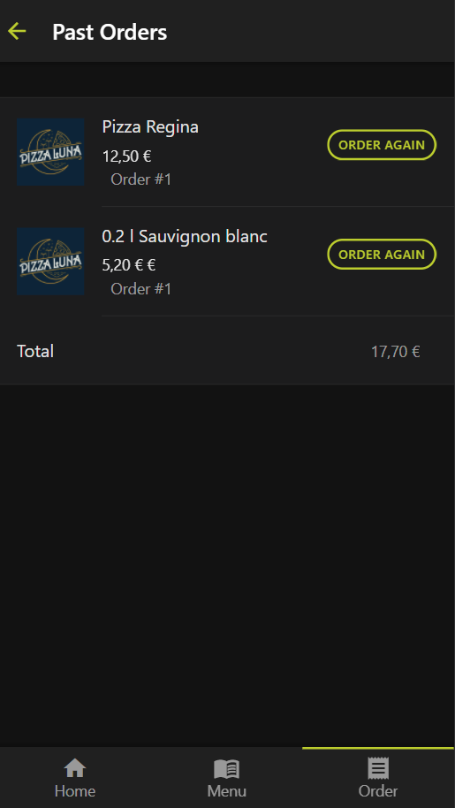
Iteration
Ordering: Unclear order flow and logic
III
interaction and design framework
7
styled prototype + lofi web prototype
8
qualitative evaluation, understanding users
9
Notes:
● when asked about what users felt the purpose of “Past Orders”
some users thought it was an order archive or order history
others thought it was for meals ordered that same day during the restaurant visit

Slide 14
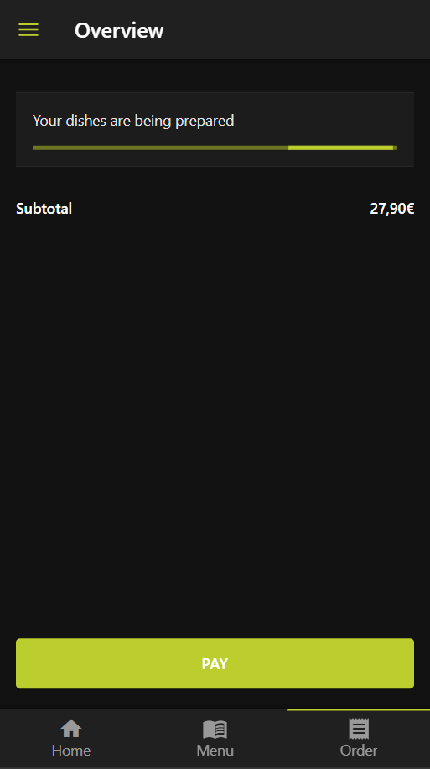
Iteration
General: confirmations or feedback after actions
III
interaction and design framework
7
styled prototype + lofi web prototype
8
qualitative evaluation, understanding users
9
Notes:
● in general we needed to add more confirmations and feedback (such as pop-up’s) after actions.
which is something we were already planning to do in future iterations.

Slide 15
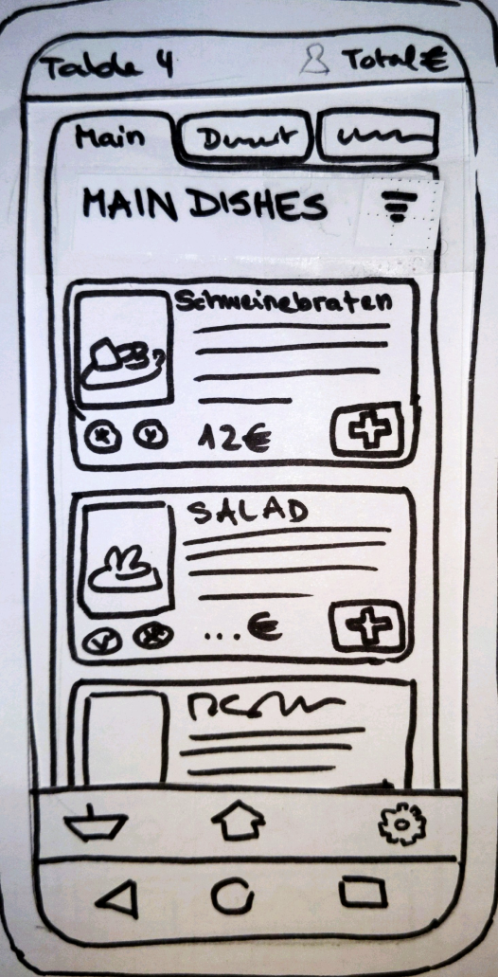
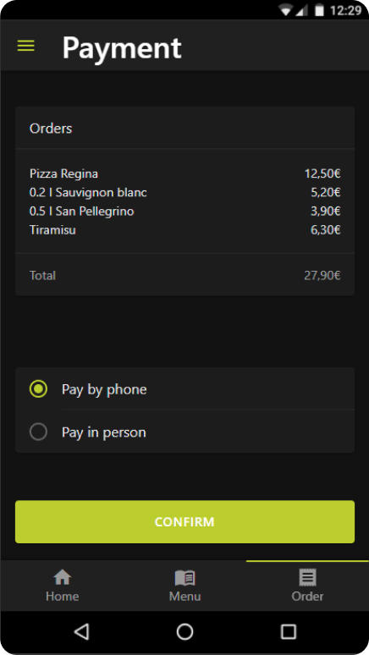
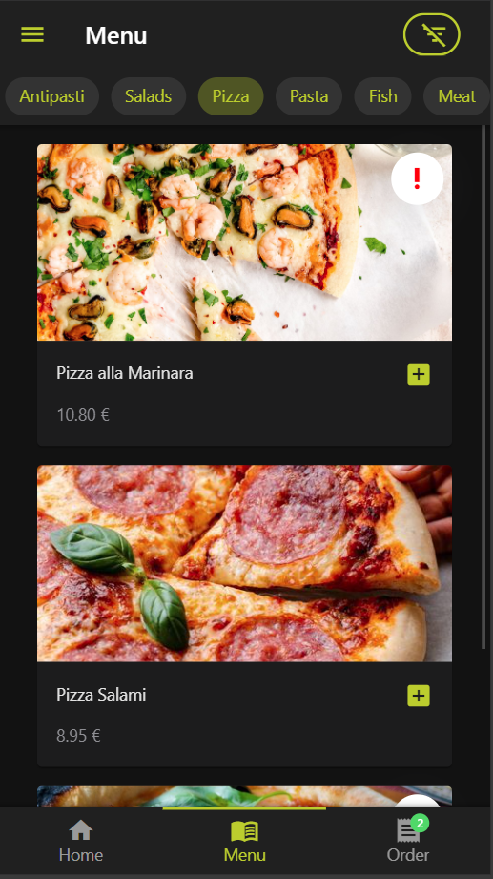
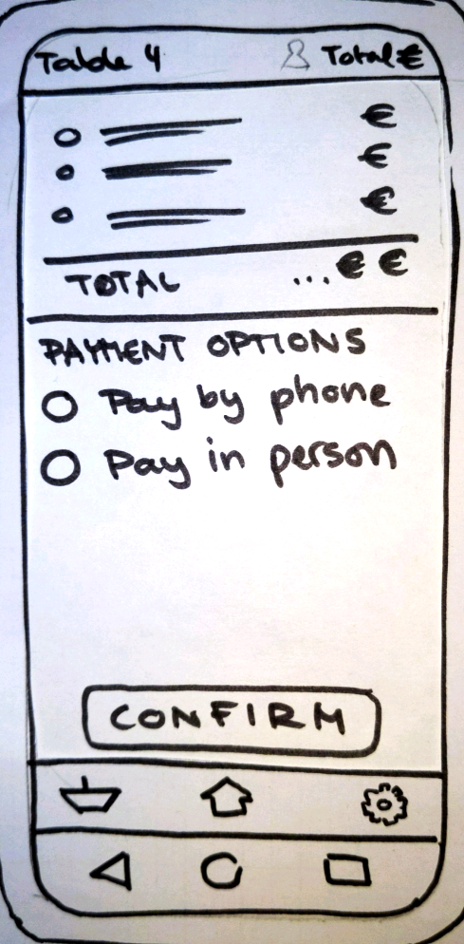
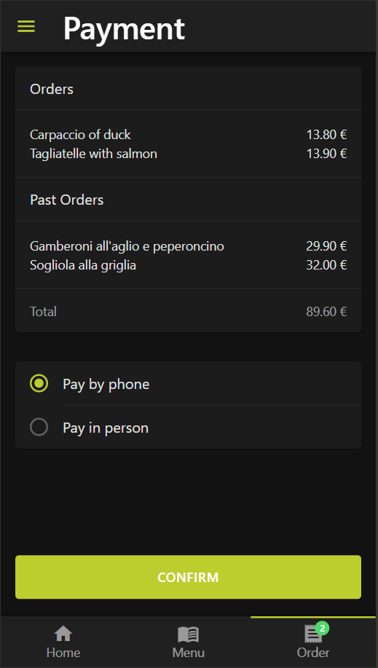
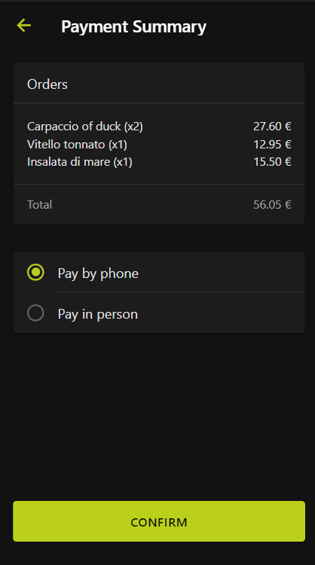
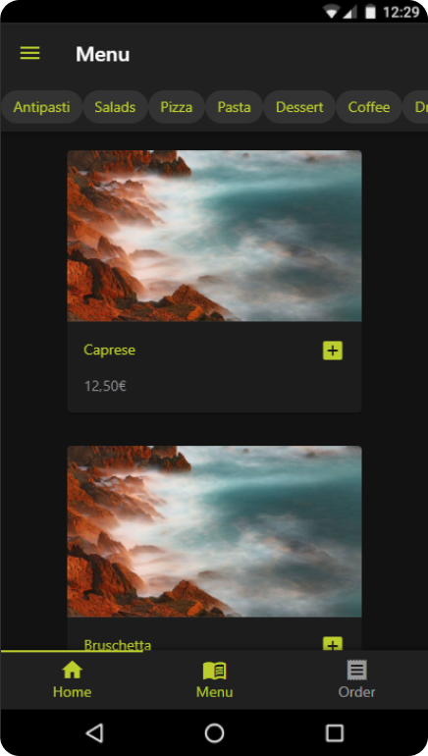

Iteration
IV
10
HiFi Web Prototype
Paper II
Web App I
Web App II
Final

Slide 16



Quantitative Evaluation
Iteration
V
System scores at least 80 in the SUS [2]
11
Final Evaluation
Task completion rate of 90% for ordering food [3]
Average number of errors per task is not higher than 0.66
Users remember at least 80% of the total features after completing the tasks
The average number of clicks must not deviate from the best case by more than 2 clicks
The user is able to order a previously determined dish within 15 seconds, starting on the home screen until the order is placed
Notes:
green = hypothesis fulfilled
orange = it’s complicated
red = not fulfilled

Slide 17
Results
Iteration
V
App should be easier and faster to use for novice users
Prevention of unnecessary clicks
Less features might improve memorability of important features
O
11
Final Evaluation

Slide 18

Prototype Live Demo
PLEASE STAND BY

Slide 19
Discussion

Slide 20
Sources
[1] Statista. (2022, 7. Februar). Android und iOS - Marktanteile am Absatz in Deutschland bis 2021 | Statista.
[2] Bangor, Aaron; Kortum, Philip T.; Miller, James T. (2008): An Empirical Evaluation of the System Usability Scale. In: International Journal of Human-Computer Interaction 24 (6), S. 574–594. DOI: 10.1080/10447310802205776.
[3] Sauro, J. (2010). A practical guide to measuring usability. https://measuringu.com/wp-content/uploads/2017/05/quantitativeusabilitytestonline.pdf

